Slide 1
Axon AI’s Solution to the 2nd YouTube-8M Video Understanding Challenge
Choongyeun Cho, Benjamin Antin, Sanchit Arora, Shwan Ashrafi, Peilin Duan, Dang The Huynh, Lee James, Hang Tuan Nguyen, Moji Solgi, Cuong Van Than
Axon AI

Slide 2
YouTube-8M challenge
6.1M video IDs
3862 classes
Multi-class Multi-label video classification.
Evaluation metric: Global Average Precision (GAP).

Slide 3
Challenge strategy
Pre-process
Training
Post-process
Model compression < 1GB
Data augmentation
Submodels ensembling
Label relationship
Knowledge distillation

Slide 4
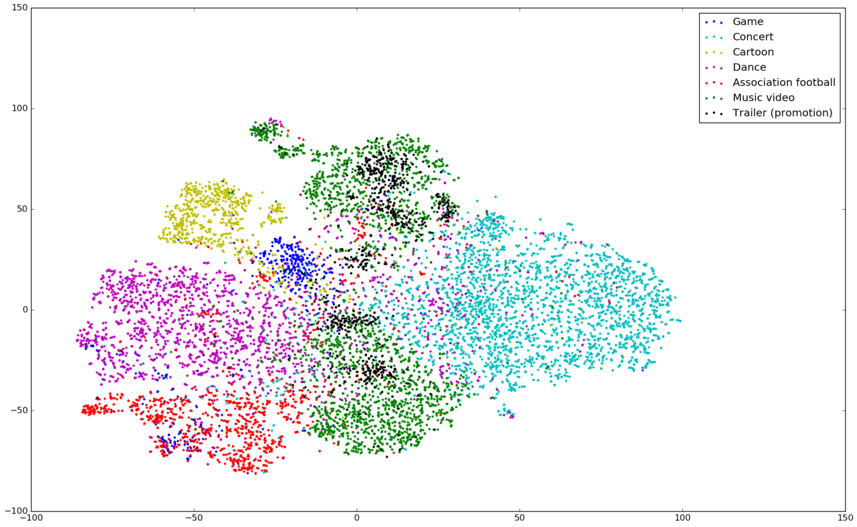
Pre-process
Training
Post-process
Model compression < 1GB
Data augmentation
Submodels ensembling
Label relationship
Knowledge distillation
Observation: videos associated with a same label form a cluster, whereas others are separated to some degree.
TSNE plot of visual features for a few selected classes
Notes:
Lambda=0.5 and sigma=0.03

Slide 5
Pre-process
Training
Post-process
Model compression < 1GB
Data augmentation
Submodels ensembling
Label relationship
Knowledge distillation
Data augmentation is for visual features only, by adding small noise to the feature vector.
Over-sampling: a single label with less than 10⁴ samples. For each sample x_{i}, find K nearest neighbors x_{j} (L2-distance)
Interpolation:
Extrapolation:
Sub-sampling (random-sampling): a single label with more than 10⁴ samples.
Notes:
Lambda=0.5 and sigma=0.03

Slide 6
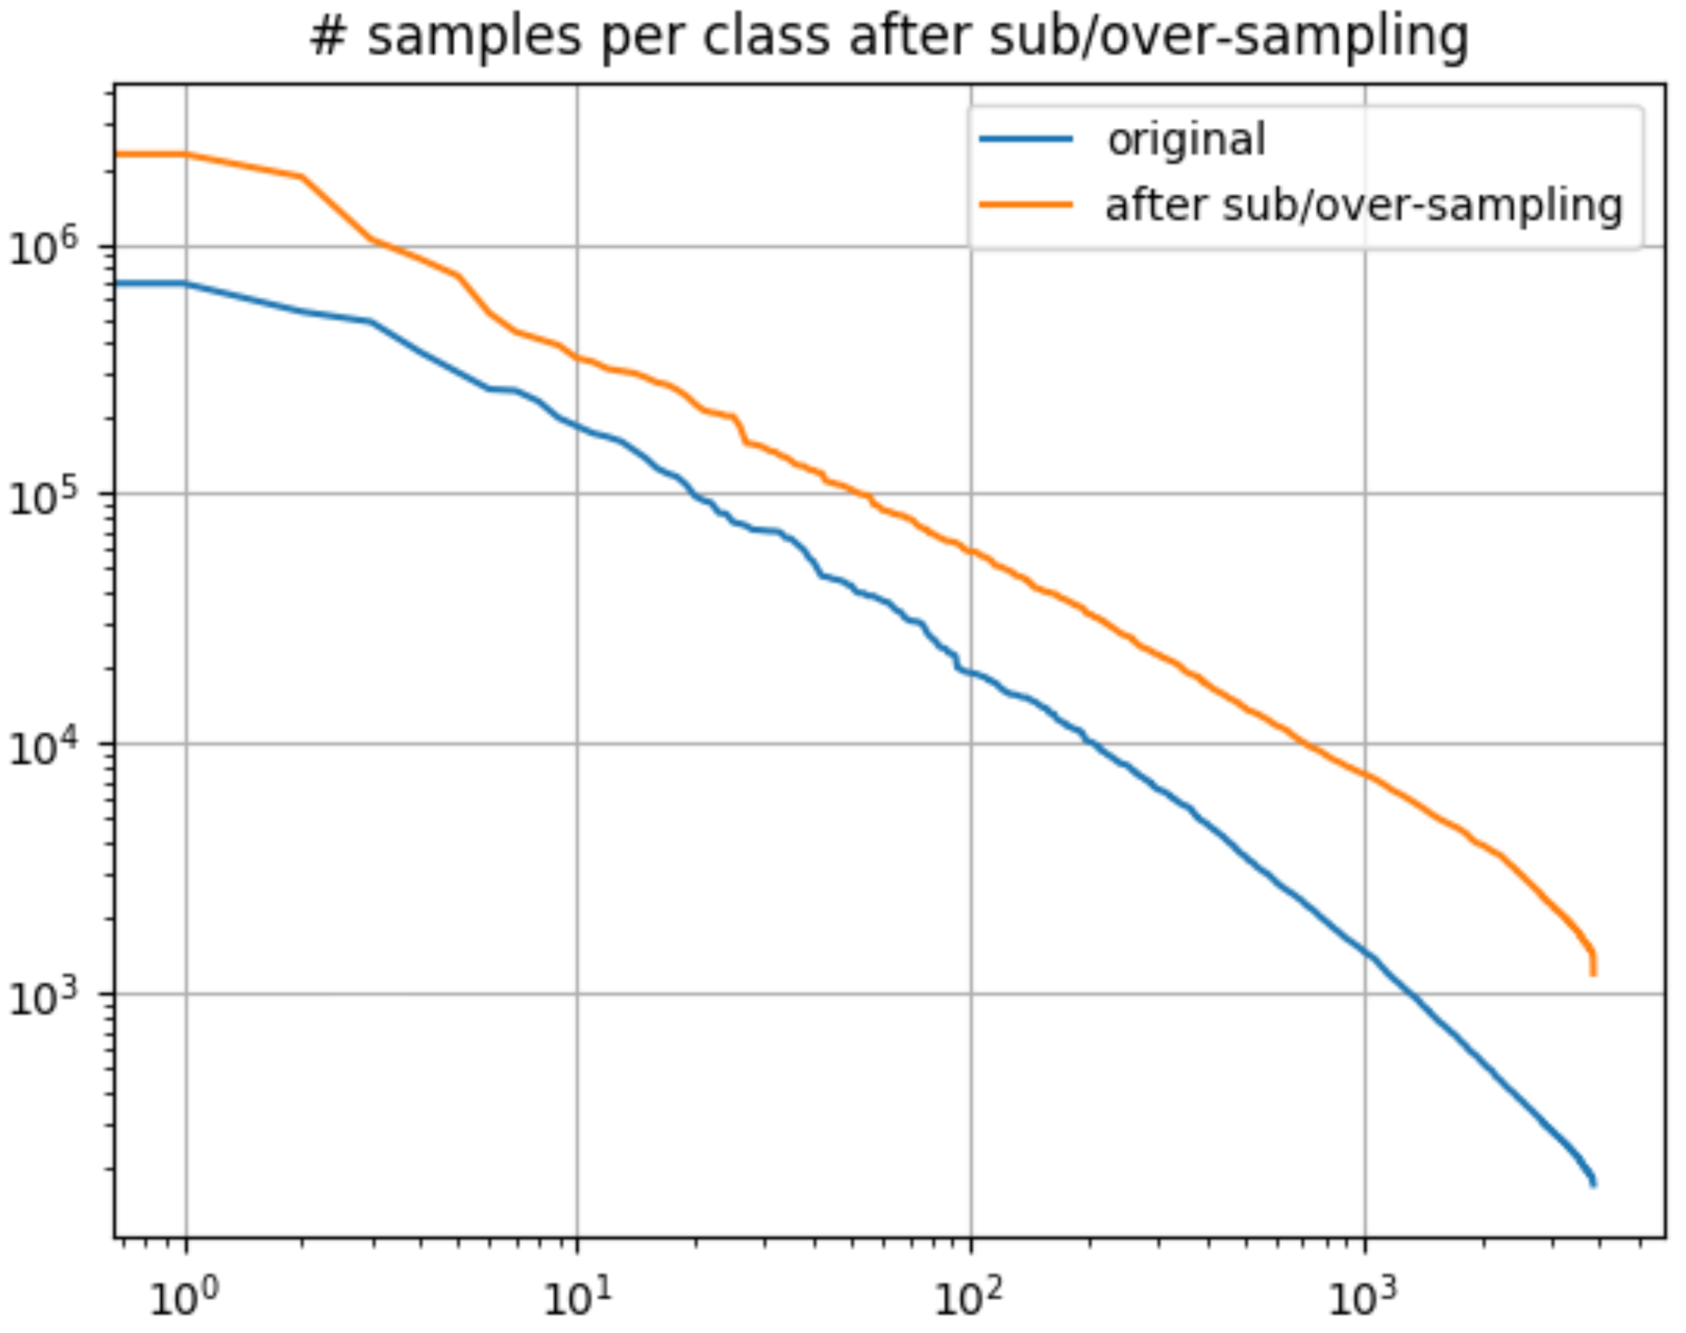
Pre-process
Training
Post-process
Model compression < 1GB
Data augmentation
Submodels ensembling
Label relationship
Knowledge distillation
Before data augmentation: 5,001,275; After data augmentation: 23,590,464 (472%)
Label counts before and after data augmentation in feature space
Notes:
Lambda=0.5 and sigma=0.03

Slide 7
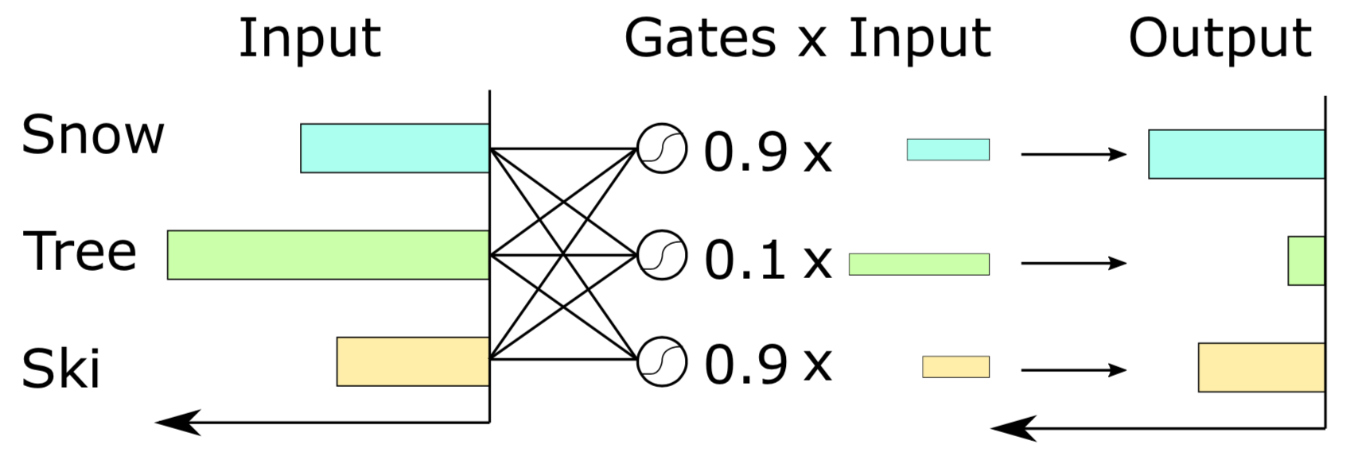
Pre-process
Training
Post-process
Model compression < 1GB
Data augmentation
Submodels ensembling
Label relationship
Knowledge distillation
Identify powerful and efficient baseline models (last-year winners) regardless of their model sizes:
Training set: train????.tfrecord + validate???[0-4,6-9].tfrecord
Validation set: validate???5.tfrecord
Baseline models:
Model family | Brief description
Learnable Pooling | Gated NetVLAD with 256 clusters
Learnable Pooling | Gated NetFV with 128 clusters
Bag of Words | Gated soft-DBoW with 4096 clusters
Bag of Words | Soft-DBoW with 8000 clusters
Learnable Pooling | Gated NetRVLAD with 256 clusters
RNN | Gated recurrent unit (GRU) with 2 layers and 1024 cells per layer
RNN | LSTM with 2 layers and 1024 cells per layer
Context gating:
All models are kept original, trained with Adam optimizer (LR = 0.0002 with exponential decay 0.8 for every 4M samples)
Notes:
Lambda=0.5 and sigma=0.03

Slide 8
Pre-process
Training
Post-process
Model compression < 1GB
Data augmentation
Submodels ensembling
Label relationship
Knowledge distillation
Approach: combine efficient submodels to have a better performance.
Experiment | Test GAP (%)
Single baseline model (gated NetVLAD) | 85.75 (Val GAP)
Single gated NetVLAD model + video-level MoE model trained with augmented dataset in feature space | 85.98 (Val GAP)
Single gated NetVLAD model + regularized DNN exploiting label relationship | 87.88 (Val GAP)
A simple average ensembling of all of the 7 models | 88.27
A simple average ensembling of two sets of all of the 7 models (14 models in total) | 88.62
Ensembled using learned weights | 88.73
Distilled model | 87.32
GAP performance per experiment
Notes:
Lambda=0.5 and sigma=0.03

Slide 9
Pre-process
Training
Post-process
Model compression < 1GB
Data augmentation
Submodels ensembling
Label relationship
Knowledge distillation
Approach: … but how to combine?
Simple average
Per-model linearly-weighted average
Per-model and per-class linearly-weighted average
Model | Weight
Gated NetVLAD | 0.2367
Gated NetFV | 0.1508
Gated soft-DBoW | 0.1590
Soft-DBoW | 0.1000
Gated NetRVLAD | 0.1968
GRU | 0.1306
LSTM | 0.0621
Learned weights for 7 baseline models.

Slide 10
Pre-process
Training
Post-process
Model compression < 1GB
Data augmentation
Submodels ensembling
Label relationship
Knowledge distillation
Exploit correlation and diversity of video label relationship, by using an extra regularization term.
where the optimal can be derived as:
Notes:
Lambda=0.5 and sigma=0.03

Slide 11
Pre-process
Training
Post-process
Model compression < 1GB
Data augmentation
Submodels ensembling
Label relationship
Knowledge distillation
Approach: training a student model ( < 1GB) based on a teacher model (ensemble of 7 baseline models).
Student model: NetVLAD with the last FC of 800 hidden weights (instead of 1024)
Loss function: weighted sum of two cross-entropy losses (with teacher model prediction and with ground truth )
Experiment | Test GAP (%)
Ensembled using learned weights | 88.73
Distilled model | 87.32
GAP performance after knowledge distillation
Notes:
Lambda=0.5 and sigma=0.03

Slide 12
References
Google: Google cloud & youtube-7m video understanding challenge (2017) https://www.kaggle.com/c/youtube8m.
Miech, A., Laptev, I., Sivic, J.: Learnable pooling with context gating for video classification (2017) Computer Vision and Pattern Recognition (CVPR) Youtube-8M Workshop.
Hinton, G., Vinyals, O., Dean, J.: Distilling the knowledge in a neural network (2014) NIPS 2014 Deep Learning Workshop.
Miech, A., Laptev, I., Sivic, J.: https://github.com/antoine77340/loupe
DeVries, T., Taylor, G.W.: Dataset augmentation in feature space (2017) https://arxiv.org/abs/1702.05538.
Rabinovich, A., Vedaldi, A., Galleguillos, C., Wiewiora, E., Belongie, S.: Objects in context (2007) IEEE ICCV.
Bengio, S., Dean, J., Erhan, D., Ie, E., Le, Q., Rabinovich, A., Shlens, J., Singer, Y.: Using web co-occurrence statistics for improving image categorization (2013) Computer Vision and Pattern Recognition (CVPR).
Deng, J., Ding, N., Jia, Y., Frome, A., Murphy, K., Bengi, S., Li, Y., Neven, H., Adam, H.: Large-scale object classification using label relation graphs (2014) ECCV.
Jiang, Y.G., Wu, Z., Wang, J., Xue, X., Chang, S.F.: Exploiting feature and class relationships in video categorization with regularized deep neural networks (2018) IEEE TPAMI 40.2.
Bober-Irizar, M., Husain, S., Ong, E.J., Bober, M.: Cultivating dnn diversity for large scale video labelling (2017) Computer Vision and Pattern Recognition (CVPR) Youtube-8M Workshop.

Slide 13
Thank you

